Slide 1

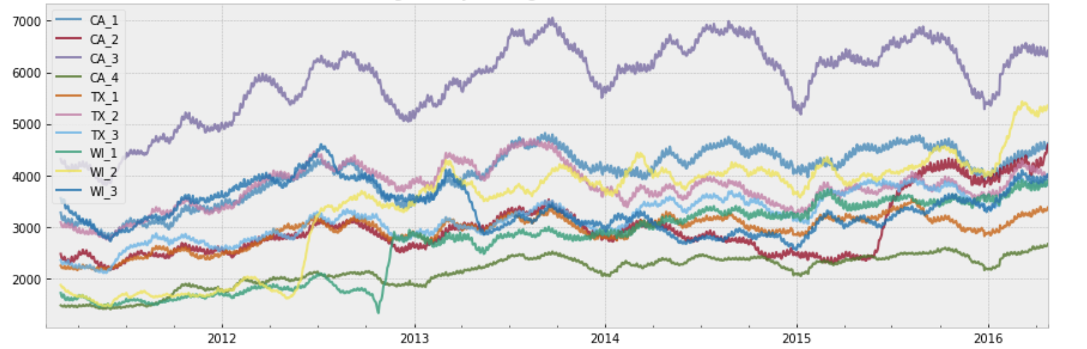
Predicting Walmart Sale – Huy Bui

Slide 2
Table of Content
Page 5
Page 21
Page 14
I. What is the problem?
III. Store-level Analysis
V. Machine learning!
VII. Conclusion
II. Product-level
Analysis
VI. Future Implementation
IV. Seasonality Analysis
Page 3
Page 16
Page 9
Page 22

Slide 3
I. What is the problem?
The Makridakis Open Forecasting Center (MOFC) at the University of Nicosia
Using 1913 days worth of data to predicting Walmart products demand for the next 4 weeks
The problem is as hard as forecasting weather, hence, many cutting-edge technology and innovative idea is used
The methods used can be applied in various business areas, such as setting up appropriate inventory or service levels

Slide 4
Data set
CALENDAR (14,1969)
Date
Week ID
Day (Day 1- Day 1969)
event name
event type
PRICES (6841121, 4)
Store ID
Item ID
Week ID
Sell Price
TRAIN (30490,1919)
Product ID
Item ID
Category
State
Dept ID
Store ID
Day 1 – Day 1913

Slide 5
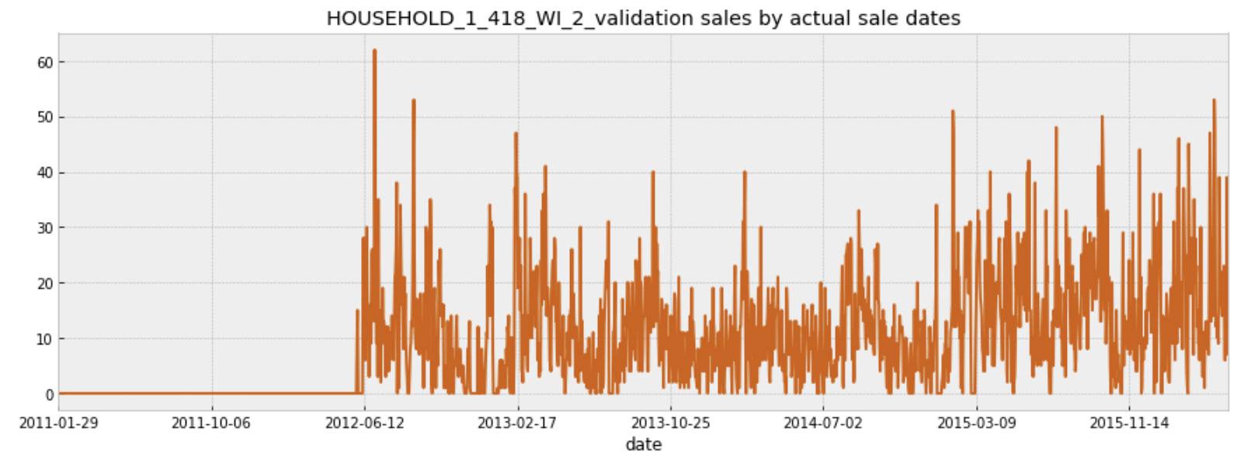
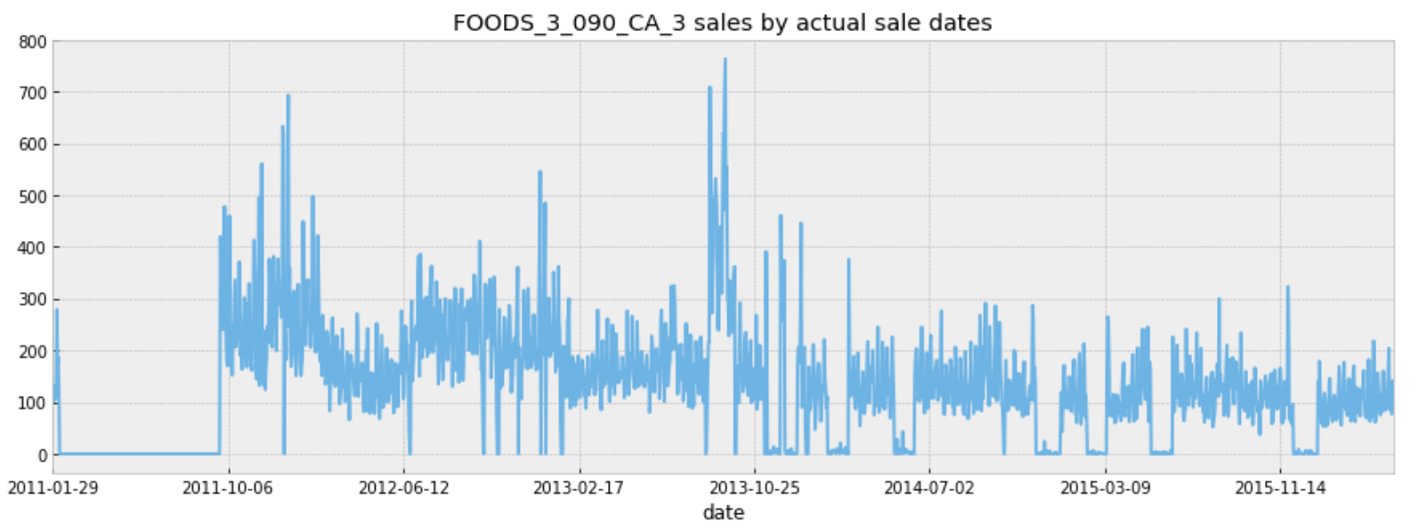
II. Product-level Analysis

Slide 6
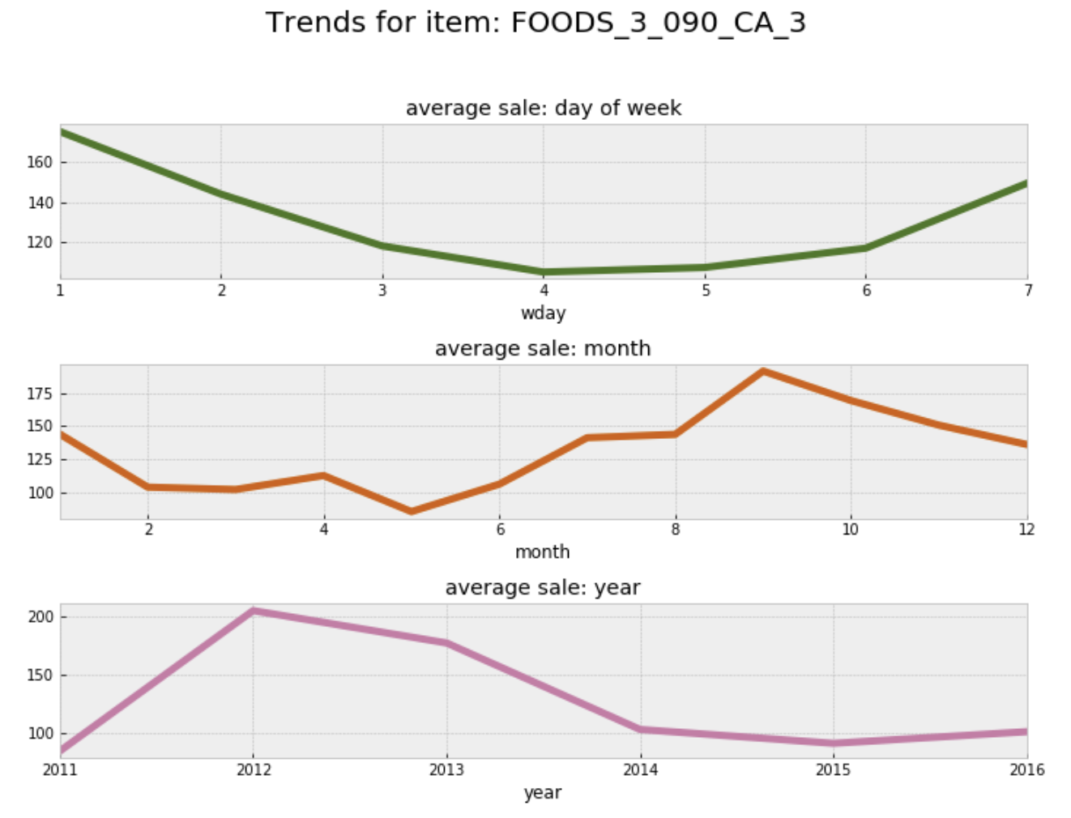
Day, month, and year trend

Slide 7
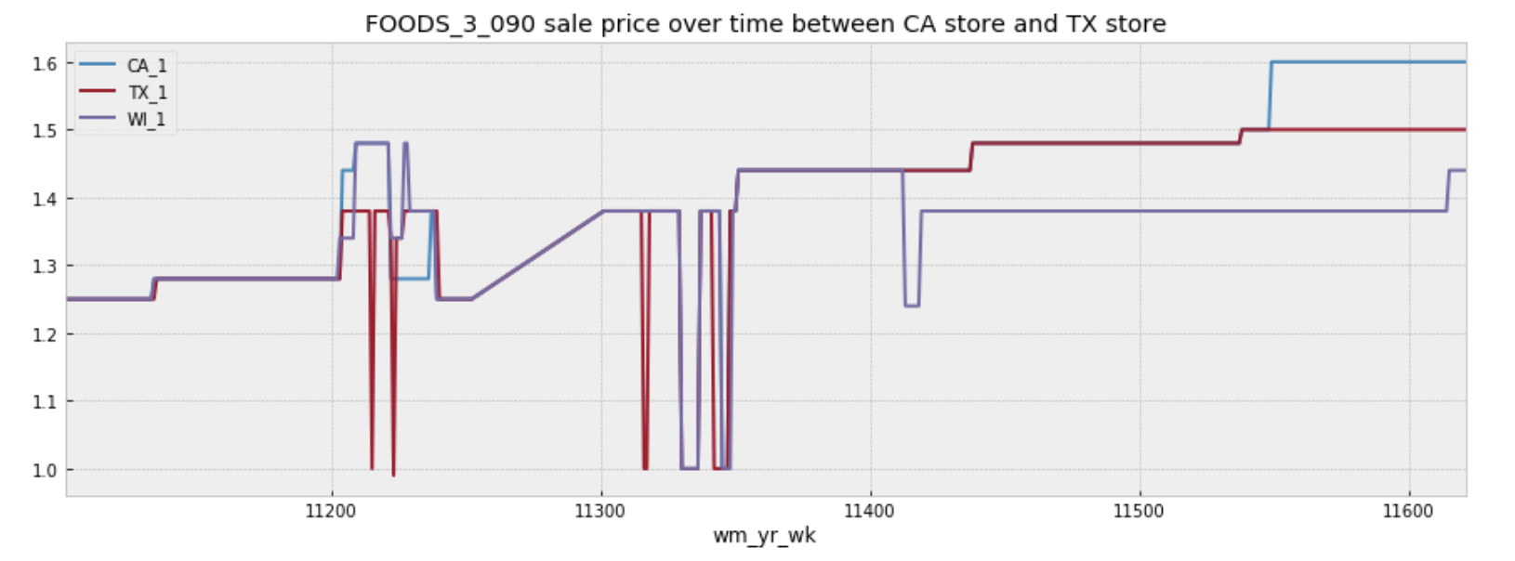
Prices between 3 stores

Slide 8
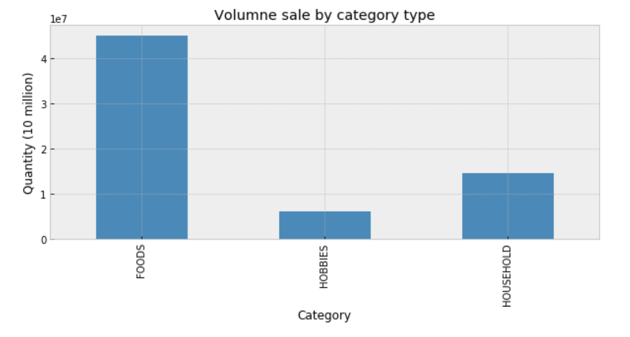
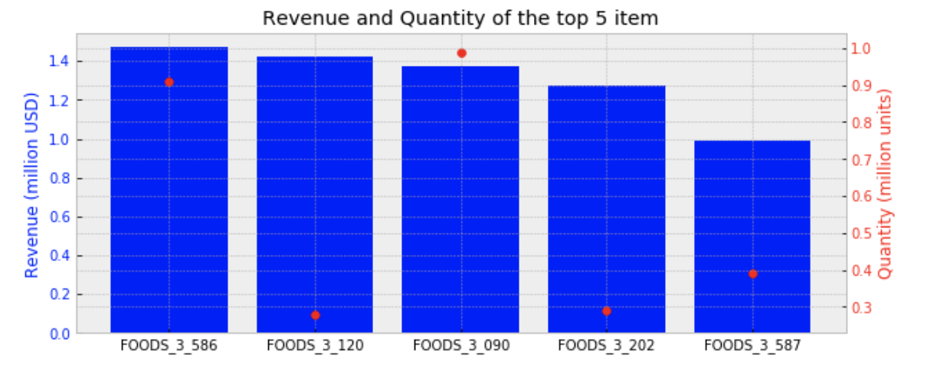
III. Store-level Analysis

Slide 9
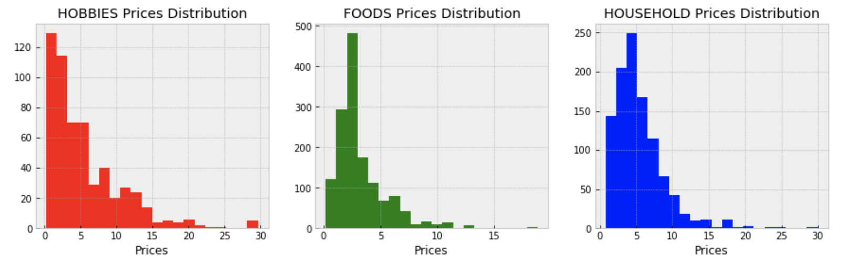
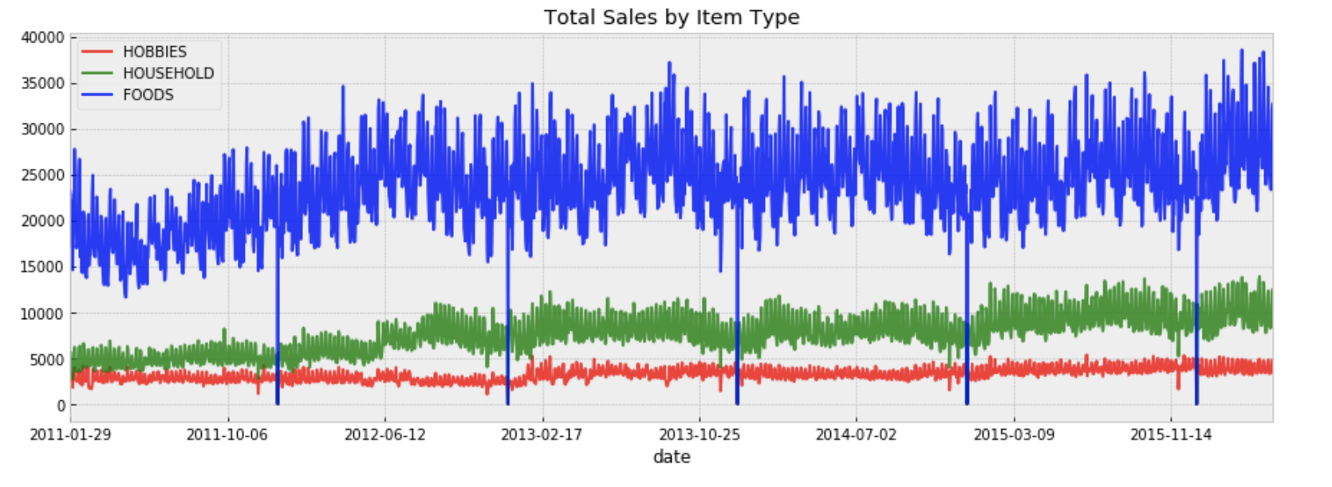
Item categories

Slide 10
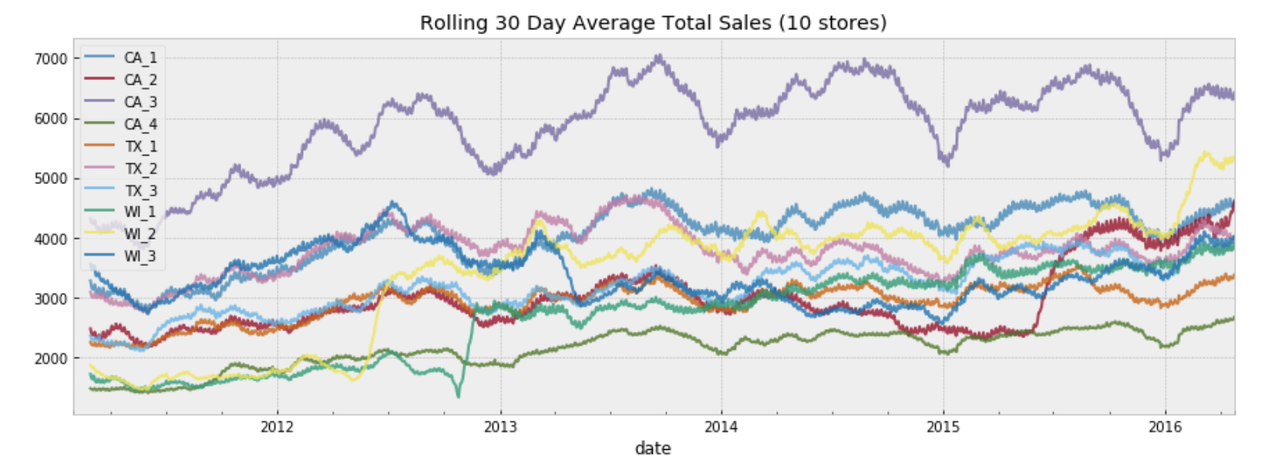
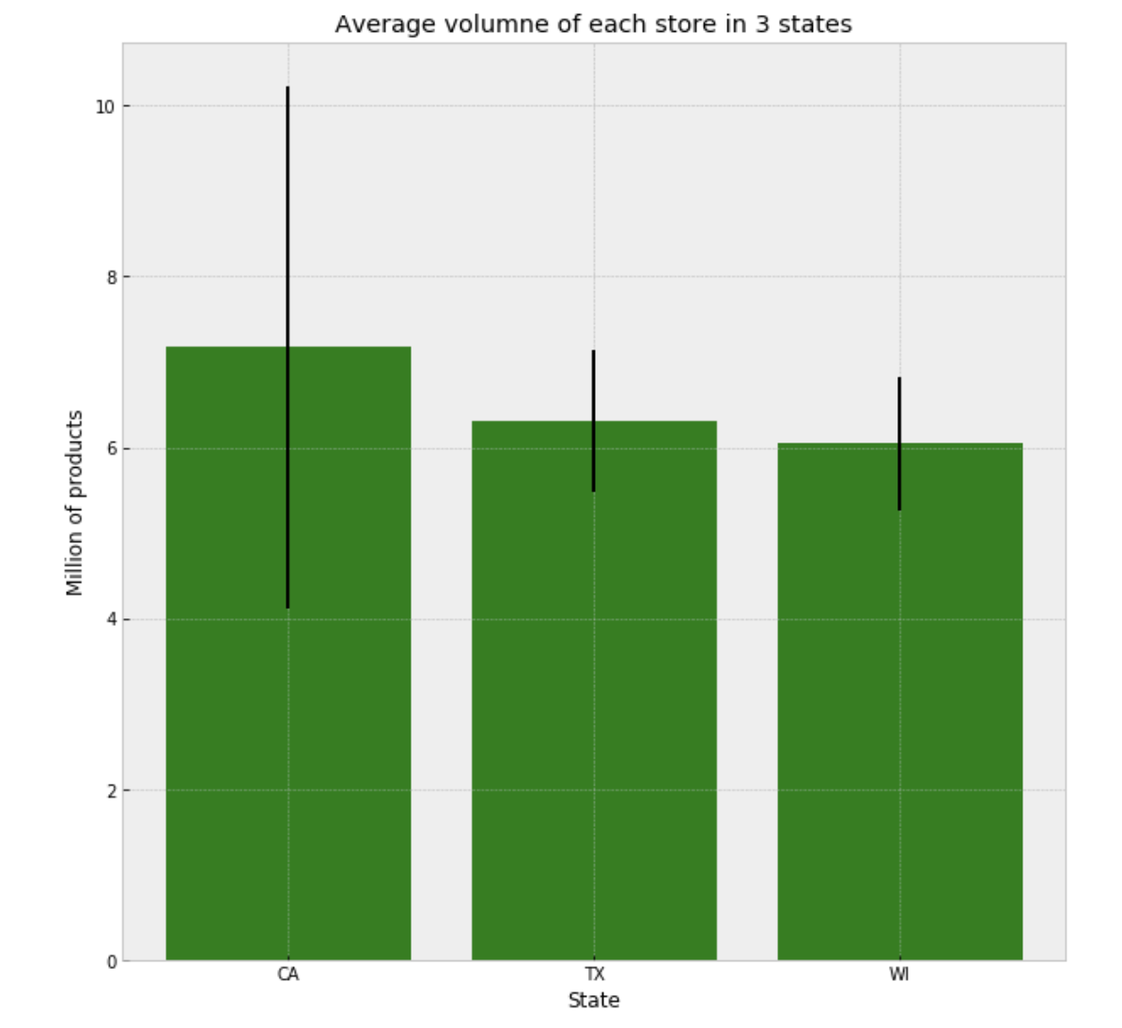
Stores sale quantity

Slide 11
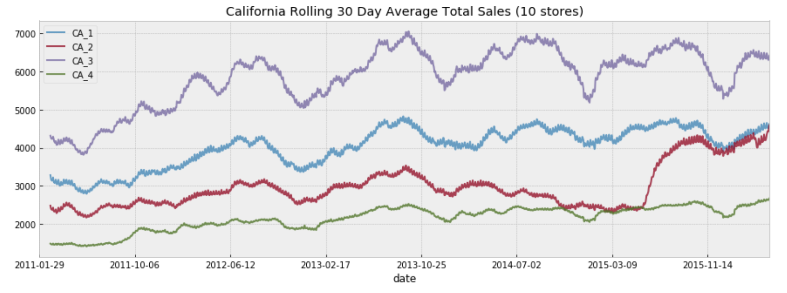
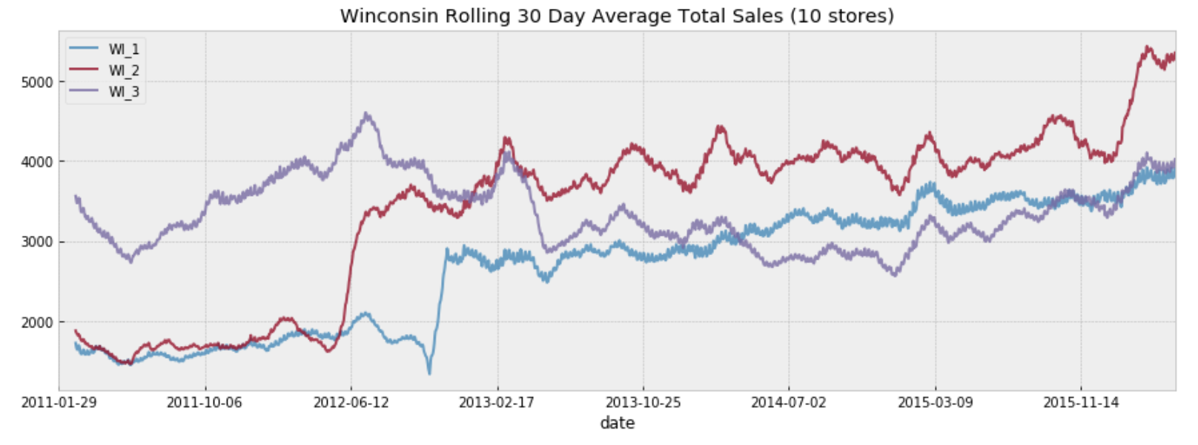
Difference between stores

Slide 12
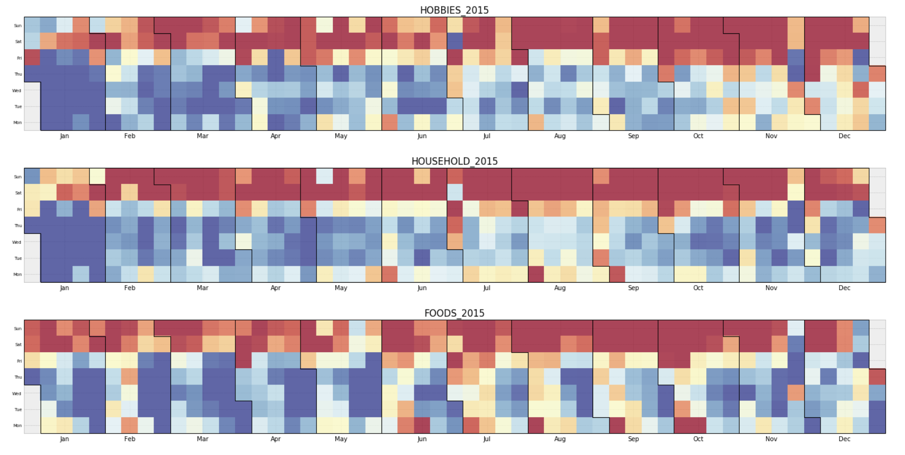
IV. Seasonality Analysis

Slide 13
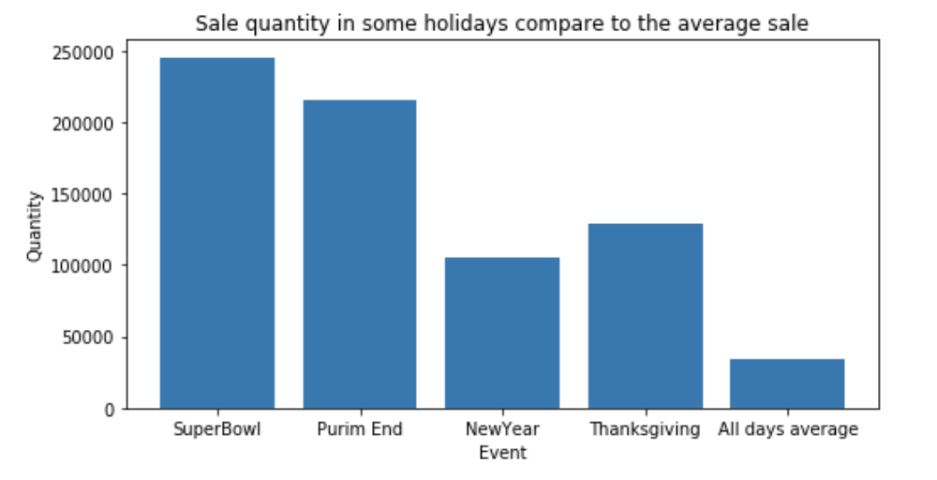
Holidays

Slide 14
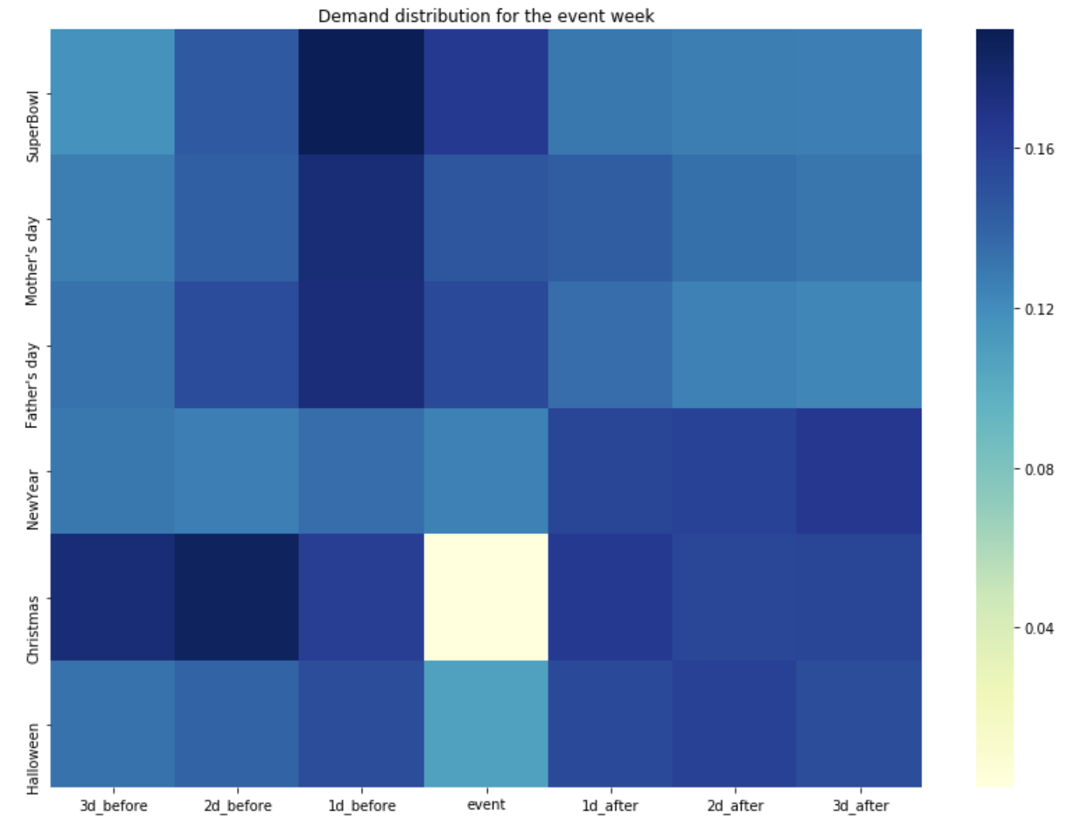
Holidays’ trend

Slide 15
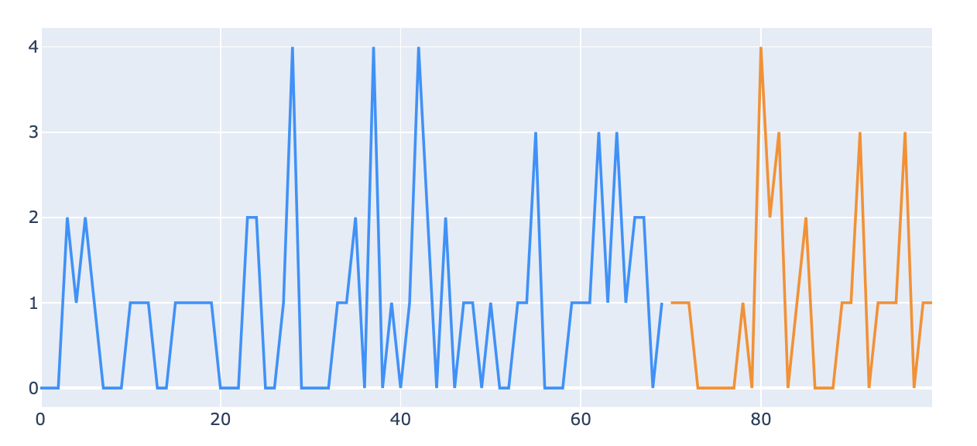
V. Machine Learning
What to predict?

Slide 16
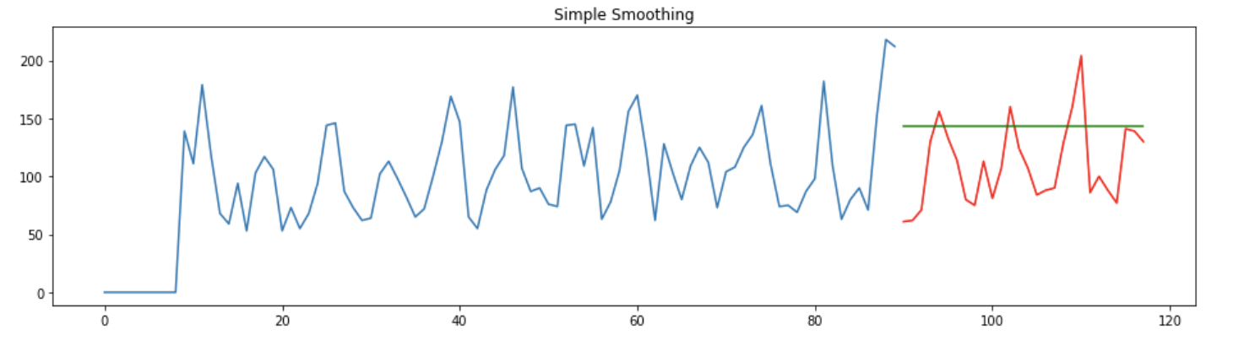
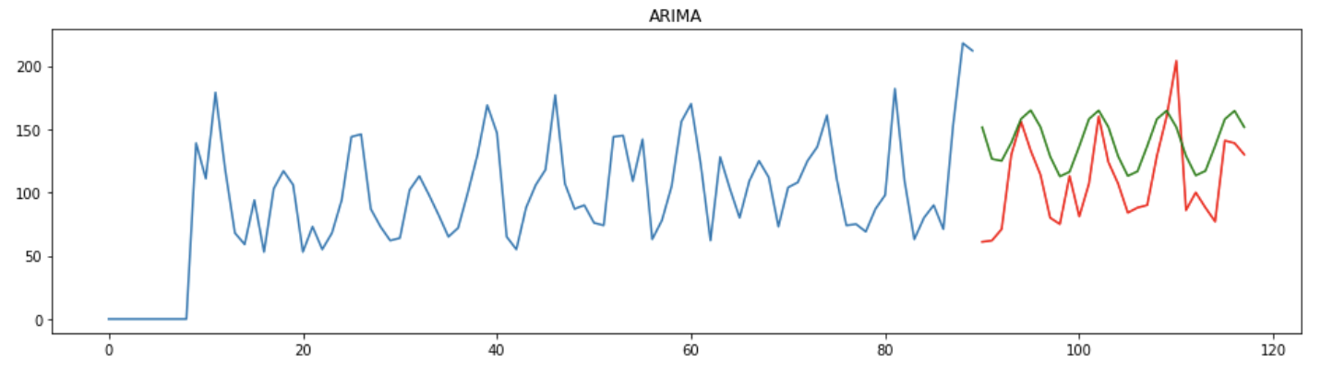
Time series traditional approach
(Simple Smoothing, ARIMA)

Slide 17
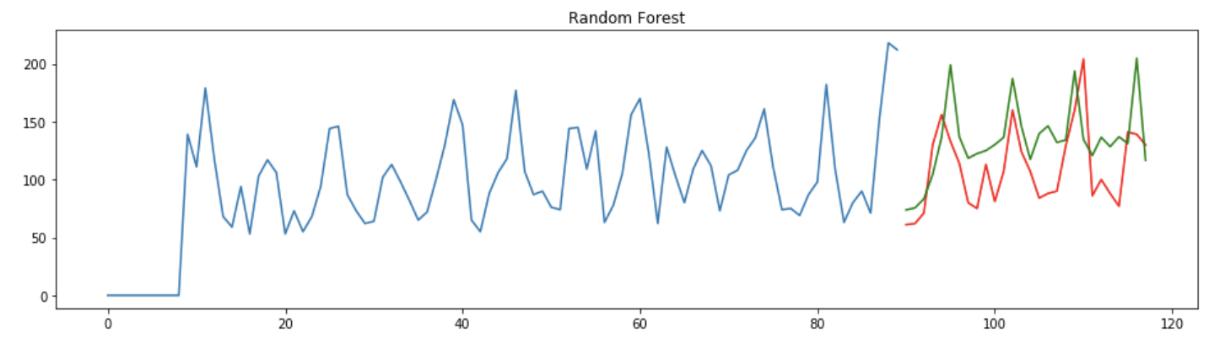
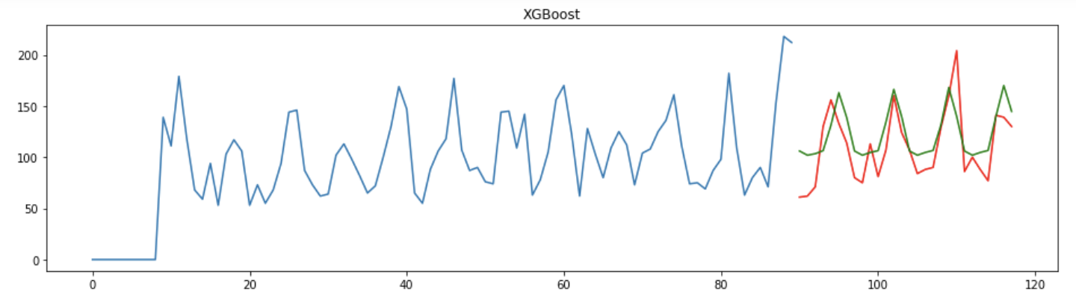
Ensemble method
(Random forest, XGBoost)

Slide 18
VI. Future Implementation
Denoise techniques (Wavelet denoising)
More feature engineer
Improve data management
FB prophet , recurrent neural network

Slide 19
Q&A

